Slide 1
BUSINESS INTELLIGENCE AND OPERATIONAL ANALYTICS

Slide 2
Executive Summary | Credit Risk & Operational Performance
Objective Analyze credit and loan application data to monitor business KPIs, identify performance trends, investigate areas of elevated default risk, and support data-driven decision-making. Executive Takeaway The analysis provides a consolidated view of portfolio and application performance, enabling management to monitor KPIs and identify segments requiring further investigation. Key Performance Indicators
KPI | Value
Total Loan Portfolio | $86M
Total Applications | 5,025
Overall Default Rate | 6.45%
Financial Exposure at Risk | $5.56M
Average FICO Score | 680
Average DTI | 17

Slide 3
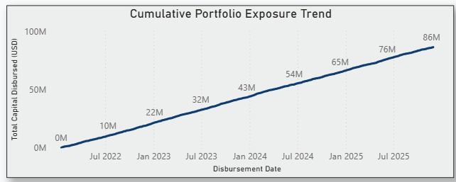
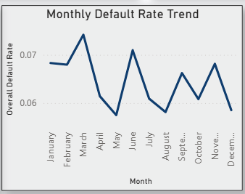
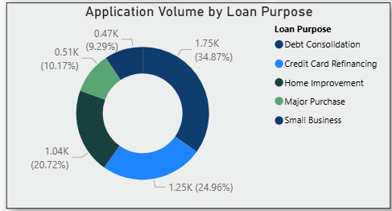
KPI & Trend Analysis
Performance & Trend Analysis
Key Areas Monitored
Portfolio Exposure: Total loan portfolio reached $86M, with cumulative exposure increasing over the analyzed period.
Default Performance: Overall default rate stands at 6.45%.
Application Activity: 5,025 applications were analyzed across multiple loan-purpose categories.
Monthly Trends: Default rates varied across months, highlighting periods requiring closer performance monitoring.
Segment Performance: Default-rate differences were observed across loan-purpose categories.
Key Insight
Monitoring KPI movement over time and across business segments helps identify performance deviations and prioritize areas for further operational investigation.

Slide 4
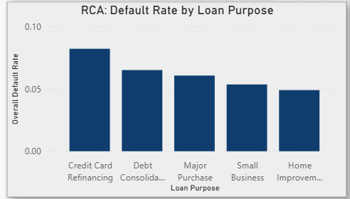
Root Cause Analysis & Key Findings
Root Cause Analysis (RCA)
RCA Approach
The overall default rate was first identified as a key performance indicator. The KPI was then drilled down by loan purpose to identify segments with relatively higher default rates and determine where performance required further investigation.
Key Findings
Credit Card Refinancing showed the highest default rate (~8.2%), making it a priority segment for further investigation.
Home Improvement recorded the lowest default rate at approximately 4.9%.
Default rates varied across loan-purpose segments, indicating differences in portfolio risk.
Higher-default segments were identified as priority areas for further operational investigation.
RCA Outcome
The analysis helped identify where the performance issue was concentrated, providing a basis for targeted monitoring and further investigation rather than assuming a direct causal relationship.

Slide 5
Recommendations & Conclusion
Business Recommendations
1. Prioritize High-Risk Segments Focus further investigation on loan-purpose segments with default rates above the overall portfolio benchmark.
2. Monitor KPI Trends Track monthly default-rate movements to identify performance deviations early.
3. Strengthen Segment-Level Monitoring Use loan-purpose and borrower-risk segmentation to identify areas requiring closer review.
4. Support Data-Driven Decisions Use KPI dashboards and RCA findings to prioritize operational actions and monitor subsequent performance.
Conclusion
The solution converts operational data into actionable KPI insights, trend analysis and RCA findings to support business decision-making.

